Slide 1
Intermediate Code Generation

Slide 2
Compiler Architecture
Intermediate Code
Parser
Static Checker
Intermediate Code generator
Code Generator
Target language
Front End
Back End
m × n compliers can be built by writing m front ends and n back ends – save considerable amount of effort
We assume parsing, static checking and IC generation is done sequentially
These can be combined and done during parsing
Static checking
Operator operand compatibility
Proper placement of break/continue keywords etc.

Slide 3
Intermediate Code (IC)
The given program in a source language is converted to an equivalent program in an intermediate language by the IC generator.
Ties the front and back ends together
Language and Machine neutral
Many forms
Level depends on how being processed
More than one intermediate language may be used by a compiler

Slide 4
Intermediate language can be many different languages, and the designer of the compiler decides this intermediate language.
Intermediate Code (IC)
syntax trees can be used as an intermediate language.
postfix notation can be used as an intermediate language.
three-address code (Quadraples) can be used as an intermediate language
quadraples are close to machine instructions, but they are not actual machine instructions.
some programming languages have well defined intermediate languages.
java
prolog
byte-code emulators

Slide 5
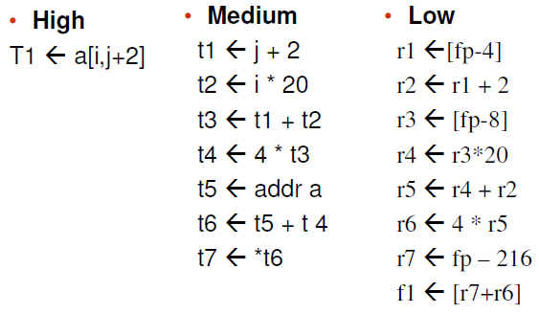
Intermediate language levels

Slide 6
Intermediate Languages Types
Graphical IRs:
Abstract Syntax trees
Directed Acyclic Graphs (DAGs)
Control Flow Graphs
Linear IRs:
Stack based (postfix)
Three address code (quadruples)

Slide 7
Graphical IRs
Abstract Syntax Trees (AST) – retain essential structure of the parse tree, eliminating unneeded nodes.
Directed Acyclic Graphs (DAG) – compacted AST to avoid duplication – smaller footprint as well
Control flow graphs (CFG) – explicitly model control flow

Slide 8
a := b *-c + b*-c
ASTs and DAGs:
:=
:=
a
+
a
+
*
b - (uni)
*
*
- (uni)
b - (uni)
b
c
c
c
AST
DAG

Slide 9
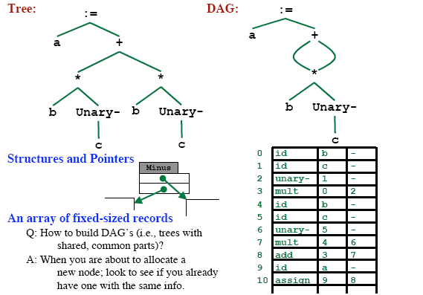
Implementation of DAG/AST: Value Number Method

Slide 10
Three-Address Code
A three-address code is:
x := y op z
where x, y and z are names, constants or compiler-generated temporaries; op is any operator.
But we may also the following notation for three-address code (it looks like a machine code instruction)
op y,z,x
apply operator op to y and z, and store the result in x.
We use the term “three-address code” because each statement usually contains three addresses (two for operands, one for the result).

Slide 11
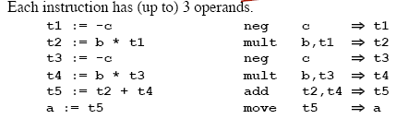
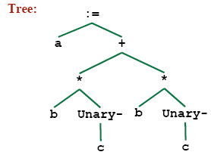
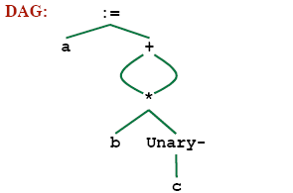
Linearized Representation of DAG/AST
Source Code
– a = b * -c + b * -c
Three address code
Tree Representation

Slide 12
Three-Address Statements
Binary Operator: op y,z,result or
result := y op z
where op is a binary arithmetic or logical operator. This binary operator is applied to y and z, and the result of the operation is stored in result.
Ex:
add a,b,c
gt a,b,c addr a,b,c
addi a,b,c
Unary Operator: op y,,result or
result := op y
where op is a unary arithmetic or logical operator. This unary operator is applied to y, and the result of the operation is stored in result.
Ex: uminus a,,c

Slide 13
Three-Address Code
Two concepts
Address
Instruction
Address
Name: source-program names to appear as addresses
Constant: Different types of constants
Compiler Generated temporary:

Slide 14
Three-Address Instruction
Assignment Type 1: x := y op z
op is a binary arithmetic or logical operation
x, y and z are addresses
Assignment Type 2: x := op z
op is a unary arithmetic or logical operation
x and z are addresses
Copy Instruction: x := y
x and z are addresses and x is assigned the value of y

Slide 15
Three-Address Instructions
Unconditional Jump: goto L
We will jump to the three-address code with the label L, and the execution continues from that statement.
Ex: goto L1 jmp 7
Conditional Jump 1: if
// jump to L1
// jump to the statement 7
x goto L and if False
x goto L
We will jump to the three-address code with the label L if x is TRUE
and FALSE, respectively. Otherwise, the following three-address instruction in sequence is executed next.
Conditional Jump 2: if x relop y goto L
We will jump to the three-address code with the label L if the result of y relop z is true, and the execution continues from that statement. If the result is false, the execution continues from the statement following this conditional jump statement.

Slide 16
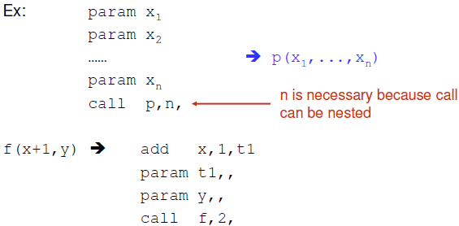
Three-Address Statements (cont.)
Procedure Parameters: param x
Procedure Calls: call p,n
where x is an actual parameter, we invoke the procedure p with
n parameters.

Slide 17
Three-Address Statements (cont.)
Indexed Assignments:
x := y[i]
sets x to the value in location i memory units beyond location y
y[i] := x
sets contents of the location i memory units beyond location y to the value of x
Address and Pointer Assignments:
x := &y
sets the r-value of x to l-value of y
x := *y
where y is a pointer whose r-value is a location
sets the r-value of x equal to the contents of that location
*x := y
sets the r-value of the object pointed by x to the r-value of y

Slide 18

Representing 3-Address Statements
op, arg1, arg2, result
x = minus y
Does not use arg2
x = y
Op is =
param a1
Uses neither arg2 nor result
Conditional/Unconditional jumps
– Put the target label in result

Slide 19
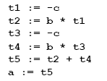
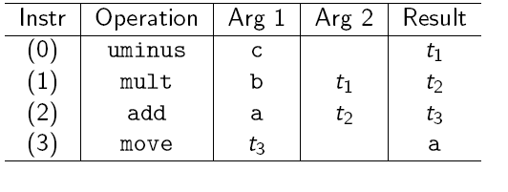
Quadruples
• a = b * -c + b * -c

Slide 20
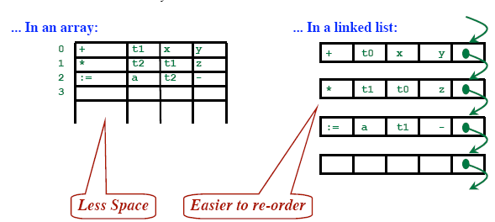
Quadruples
Store each fields directly
Operator
Result
Arg1
Arg2

Slide 21
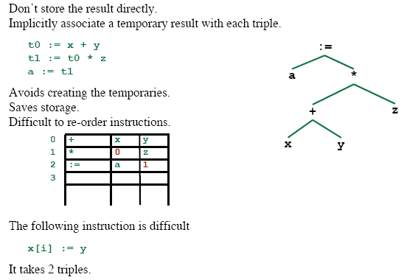
Triples
op | arg1 | arg2
[ ]= | x | i
:= | 0 | y
0
1

Slide 22
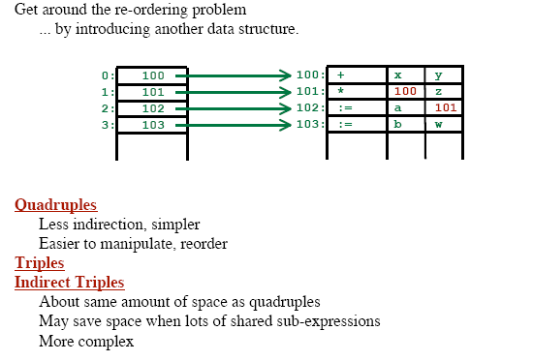
Indirect Triples

